Slide 1
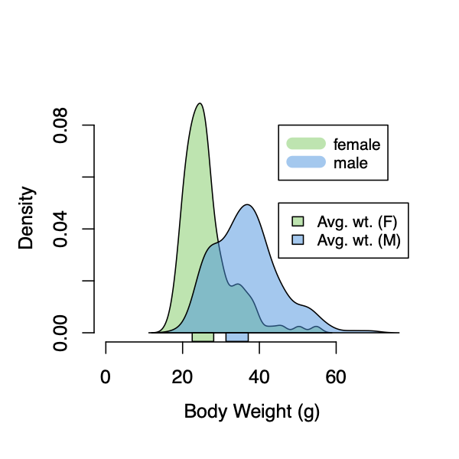
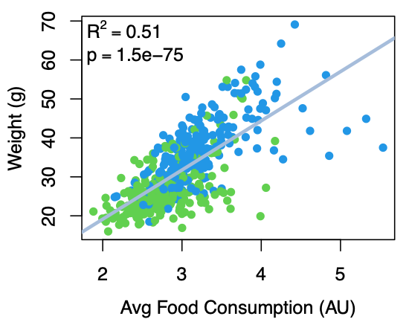
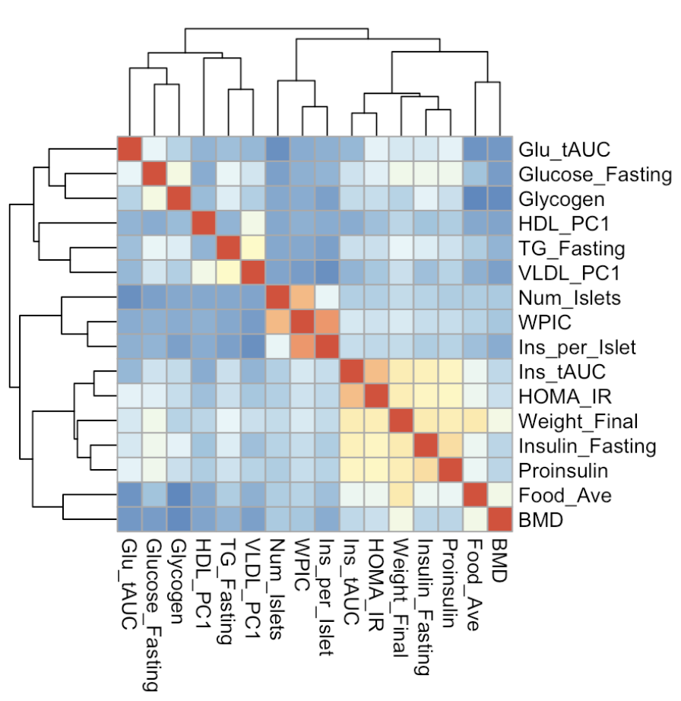
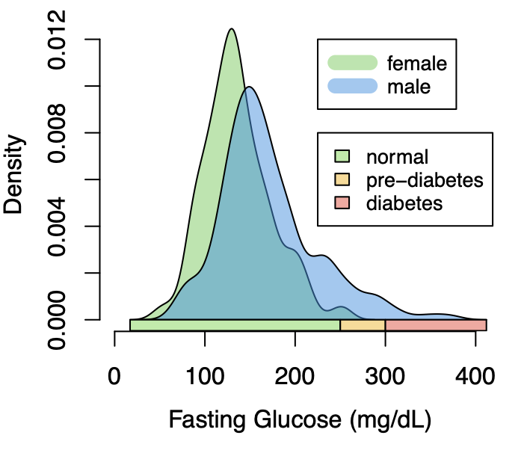
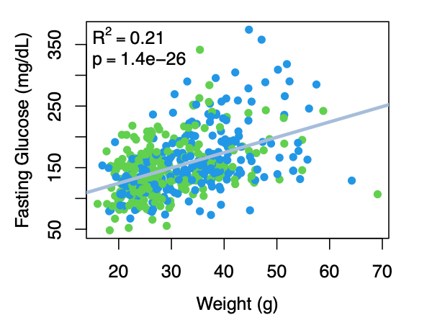
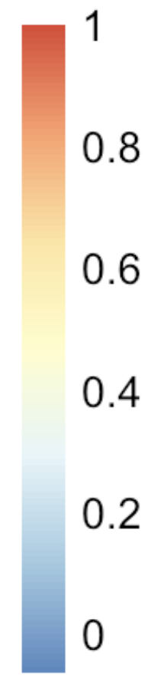
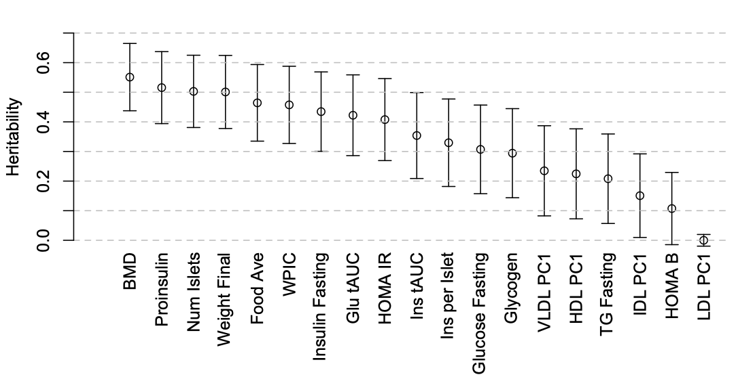
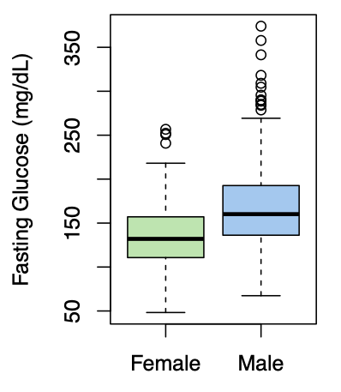
A
D
G
Figure 1: Metabolic phenotypes are heritable
B
E
0
0.2
0.4
0.6
0.8
1
C
F
Notes:
Figure 1. Clinical overview. \textbf{A.} Distributions of final body weight in the diversity outbred mice. Sex is indicated by color. The average B6 male and female adult weights at 24 weeks of age are indicated by blue and green bars on the x-axis. \textbf{B.} The distribution of final fasting glucose across the population split by sex. Normal, pre-diabetic, and diabetic fasting glucose levels for mice are shown by colored bars along the x-axis. \textbf{C.} Males had higher fasting blood glucose on average than females. \textbf{D.} The relationship between food consumption and body weight for both sexes. \textbf{E.} Relationship between body weight and fasting glucose for both sexes. \textbf{F.} Heritability estimates for each physiological trait. Bars show standard error of the estimate. \textbf{G.} Correlation structure between pairs of physiological traits.
adult B6 weight at 24 weeks:
female: 26.9 ± 3.4
male: 36.3 ± 3.4
https://www.jax.org/jax-mice-and-services/strain-data-sheet-pages/body-weight-chart-000664
blood glucose ranges for humans: https://www.cdc.gov/diabetes/basics/getting-tested.html
Not sure if this applies to mice
There was a mouse with 800 mg/dL. Is that correct, or an error. The glucose monitors only go up to 500, is that right?

Slide 2
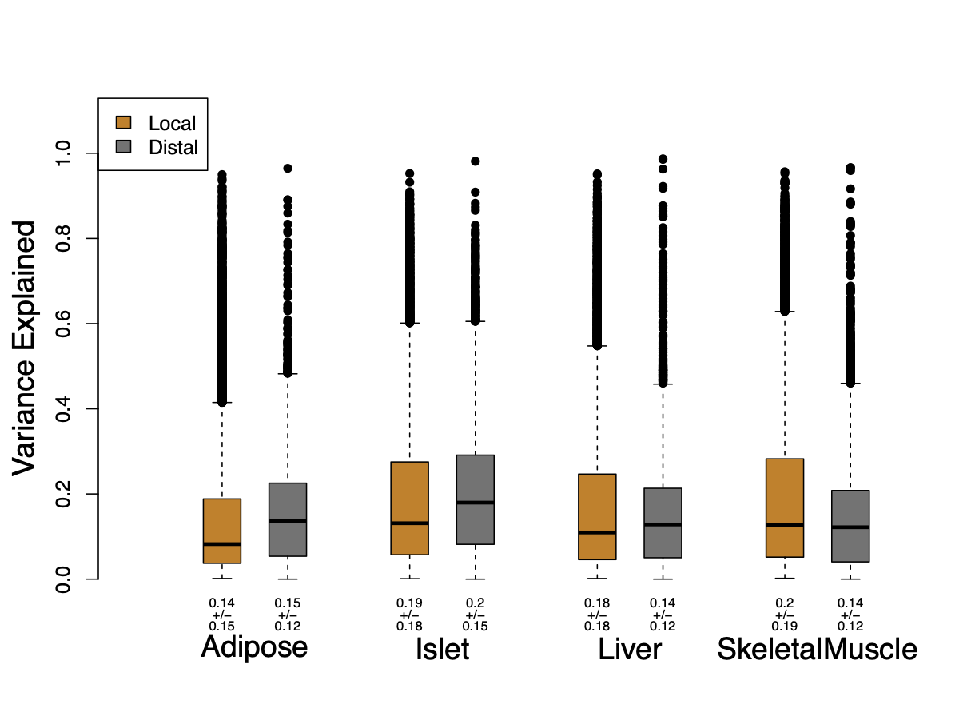
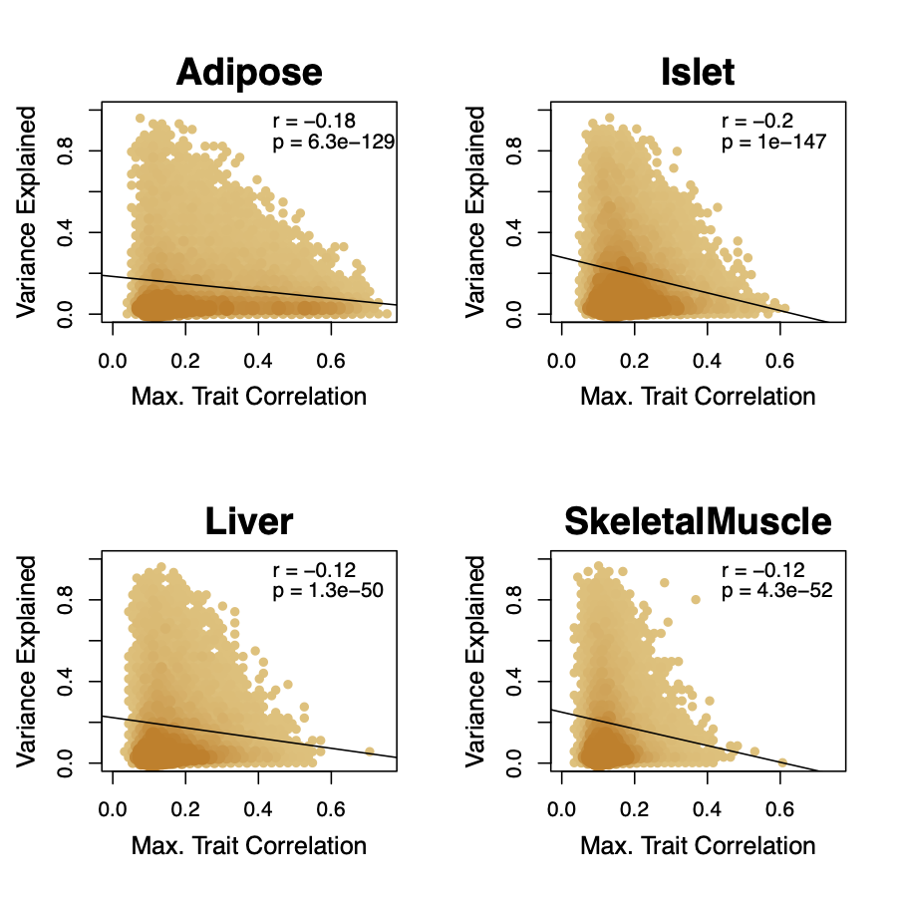
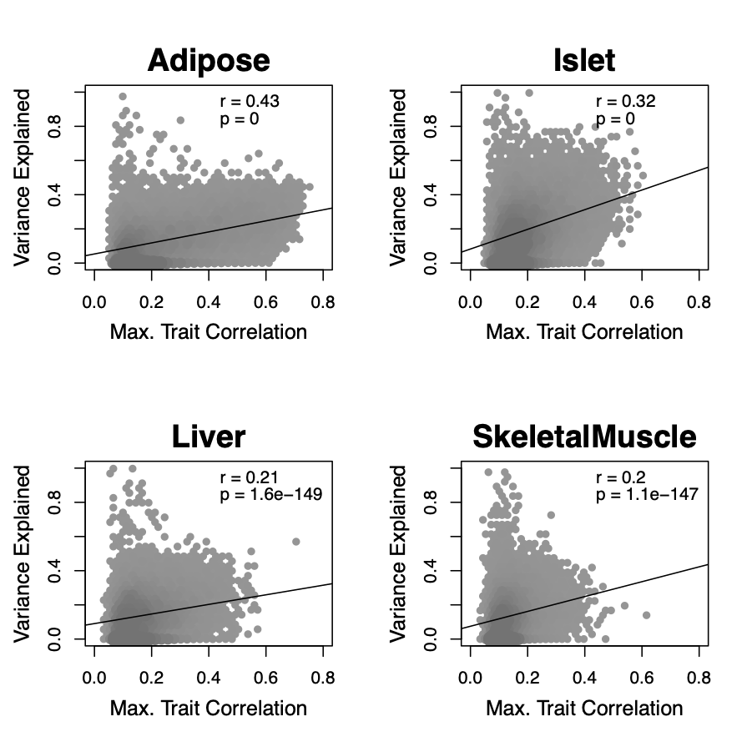
A
Figure 2: Motivation
B
C
Notes:
Figure 2: Motivation
Main points:
1 We can't just go after largest eQTLs
2. Distal variance is more highly correlated with trait correlation
Figure 2. Transcript heritability and trait relevance. \textbf{A.} Distributions of distal and local heritability of transcripts across the four tissues. Overall local and distal factors contribute equally to transcript heritability. The relationship between (\textbf{B.}) local and (\textbf{C.}) distal heritability and trait relevance across all four tissues. Here trait relevance is defined as the maximum correlation between the transcript and all traits. Local heritability is negatively correlated with trait relevance, and distal heritability is positively correlated with trait relevance. Pearson (r) and p values for each correlation are shown in the upper-right of each panel.

Slide 3
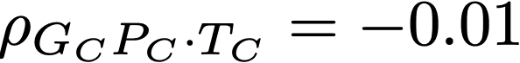
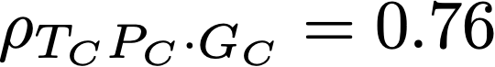
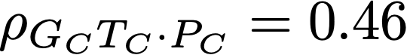
Figure 3: Workflow/Permutations
A
371 DO mice
B
Null
Observed
Genome
Transcriptome
Phenome
GigaMUGA
Bulk RNA Seq
Adipose
Islet
Liver
Skeletal Muscle
Body weight
insulin
glucose
oGTT
plasma lipids
Frequency
.
Kernelize
GK
TK
PK
Path Coefficient
C
Permuting Transcriptome
High-Dimensional Mediation
Observed
.
TC-PC correlation (r)
Permutations
𝜌 = 0.46
TC
𝜌 = 0.78
Null
GC
𝜌 = -0.01
PC
Composite Scores
GC-TC correlation (r)
Calculate Loadings
Transcript Loadings
Phenotype Loadings
Effect of increased expression on PC
The contribution of each trait to PC
Correlations vs. partial correlation notation?
Notes:
High-dimensional mediation. \textbf{A.} Workflow indicating major steps of high-dimensional mediation. The genotype, transcriptome, and phenotype matrices were kernelized to yield single matrices representing the relationships between all individuals for each data modality ($G_K$ = genome kernel, $T_K$ = transcriptome kernel; $P_K$ = phenome kernel). High-dimensional mediation was applied to these matrices to maximize the direct path $G \rightarrow T \rightarrow P$, the mediating pathway (arrows), while simultaneously minimizing the direct $G \rightarrow P$ pathway (dotted line). The composite vectors that resulted from high-dimensional mediation were $G_c$, $T_C$, and $P_C$. The partial correlations $\rho$ between these vectors indicated perfect mediation. Transcript and trait loadings were calculated as described in the methods. \textbf{B.} The null distribution of the path coefficient derived from 10,000 permutations compared to the observed path coefficient (red line). \textbf{C.} The null distribution of the $G_C$-$T_C$ correlation vs. the $T_C$-$P_C$ correlation compared with the observed value (red dot).
\rho_{G_C T_C \cdot P_C} = 0.46
\rho_{T_C P_C \cdot G_C} = 0.76
\rho_{G_C P_C \cdot T_C} = -0.01
Notes:
new name for phenotype score - metabolic health index?
use colors to indicate partial correlation

Slide 4
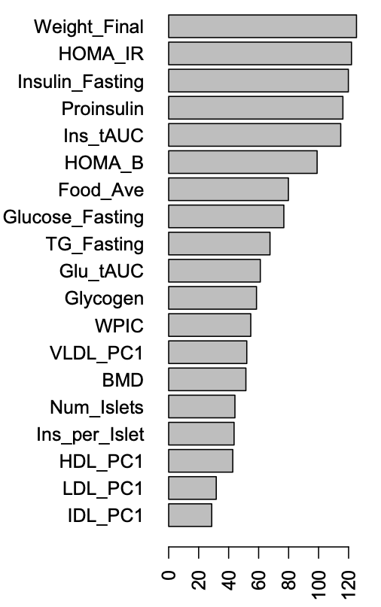
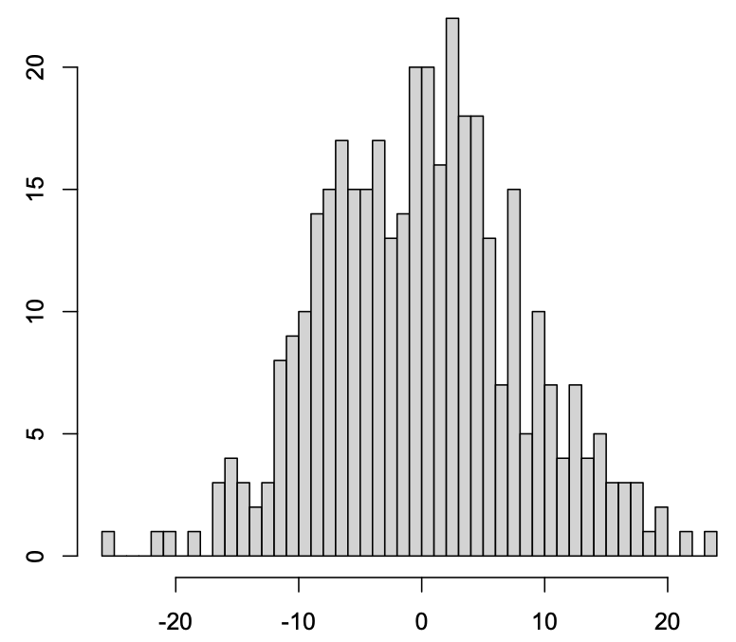
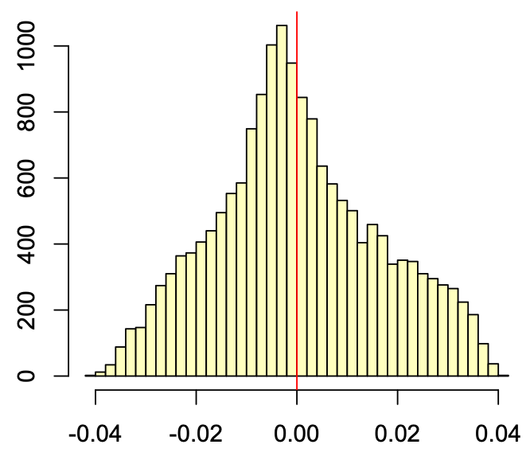
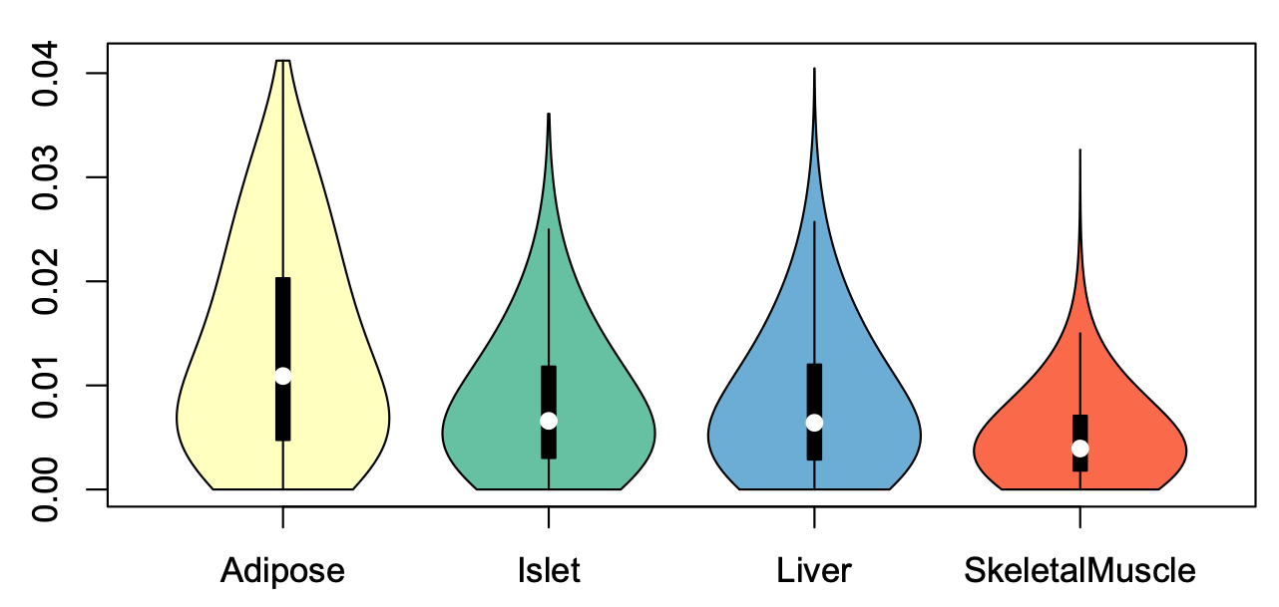
Figure 4: Biological Interpretation
A
Phenotype Loadings
B
PC (Metabolic Index)
C
Adipose Transcript Loadings
more
Negative association with metabolic index
Positive association with metabolic index
Number of Mice
Frequency
representation in PC
less
less metabolic disease
more metabolic disease
Loading
Loading
D
Notes:
Main points:
1. Interpretation of trait loadings, phenotype score, and transcript loadings
2. Loadings are strongest in adipose tissue
Interpretation of loadings. \textbf{A.} Loadings across traits. Body weight and insulin resistance contributed the most to the composite trait. \textbf{B.} Phenotype scores across individuals. Individuals with large positive phenotype scores had higher body weight and insulin resistance than average. Individuals with large negative phenotype scores had lower body weight and insulin resistance than average. \textbf{C.} Distribution of transcript loadings in adipose tissue. For transcripts with large positive loadings, higher expression was associated with higher phenotype scores. For transcripts with large negative loadings, higher expression was associated with lower phenotype scores. \textbf{D.} Distribution of absolute value of transcript loadings across tissues. Transcripts in adipose tissue had the largest loadings indicating that transcripts in adipose tissue were the best mediators of the genetic effects on body weight and insulin resistance.
Notes:
add adipose information for C.
propagate whatever name we use for phenotype score to here.

Slide 5
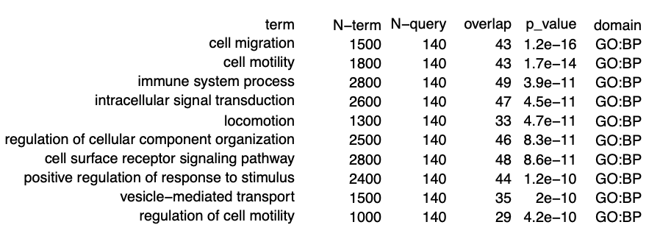
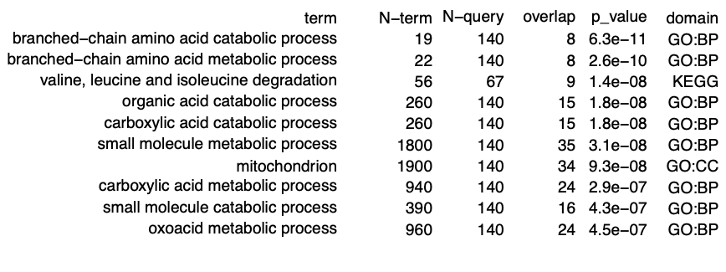
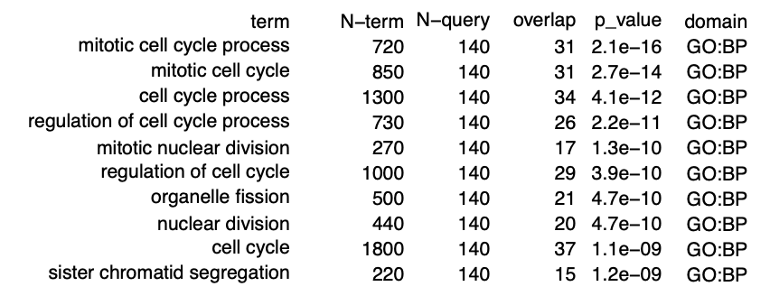
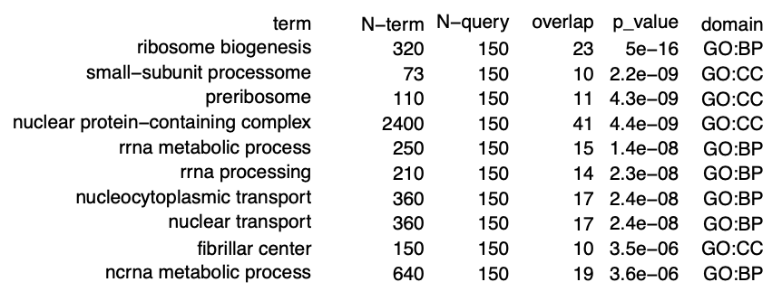
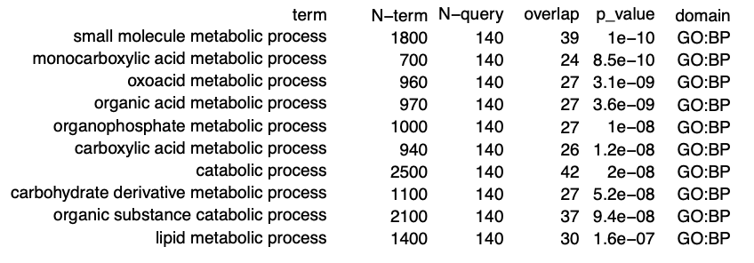
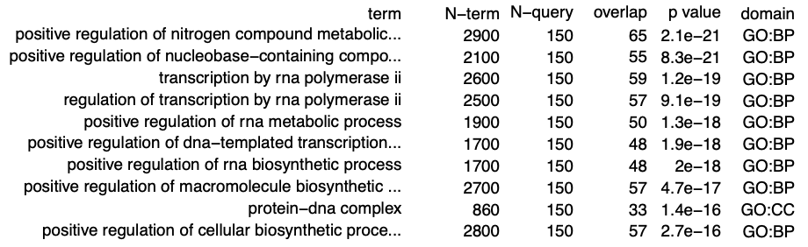
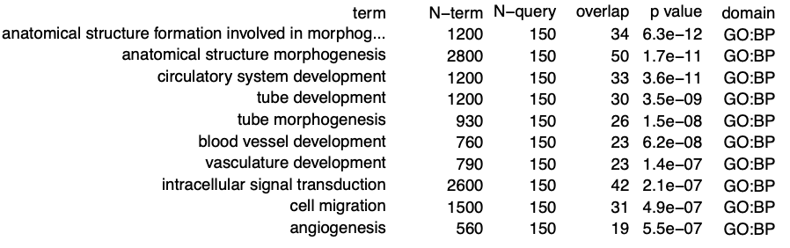
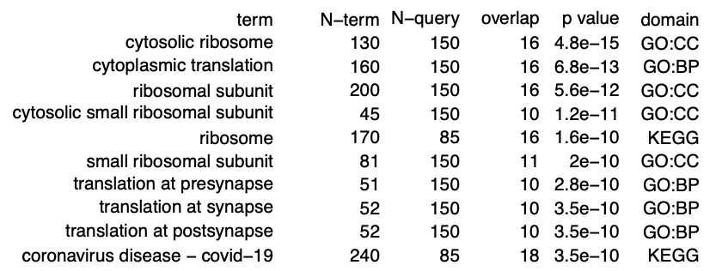
Supplemental Figure
Positive Loadings
Negative Loadings
Adipose
Islet
Liver
Muscle
Notes:
Supplemental Figure: Tables showing top 10 functional enrichments for the 150 transcripts with the largest positive and negative loadings across all four tissues.

Slide 6
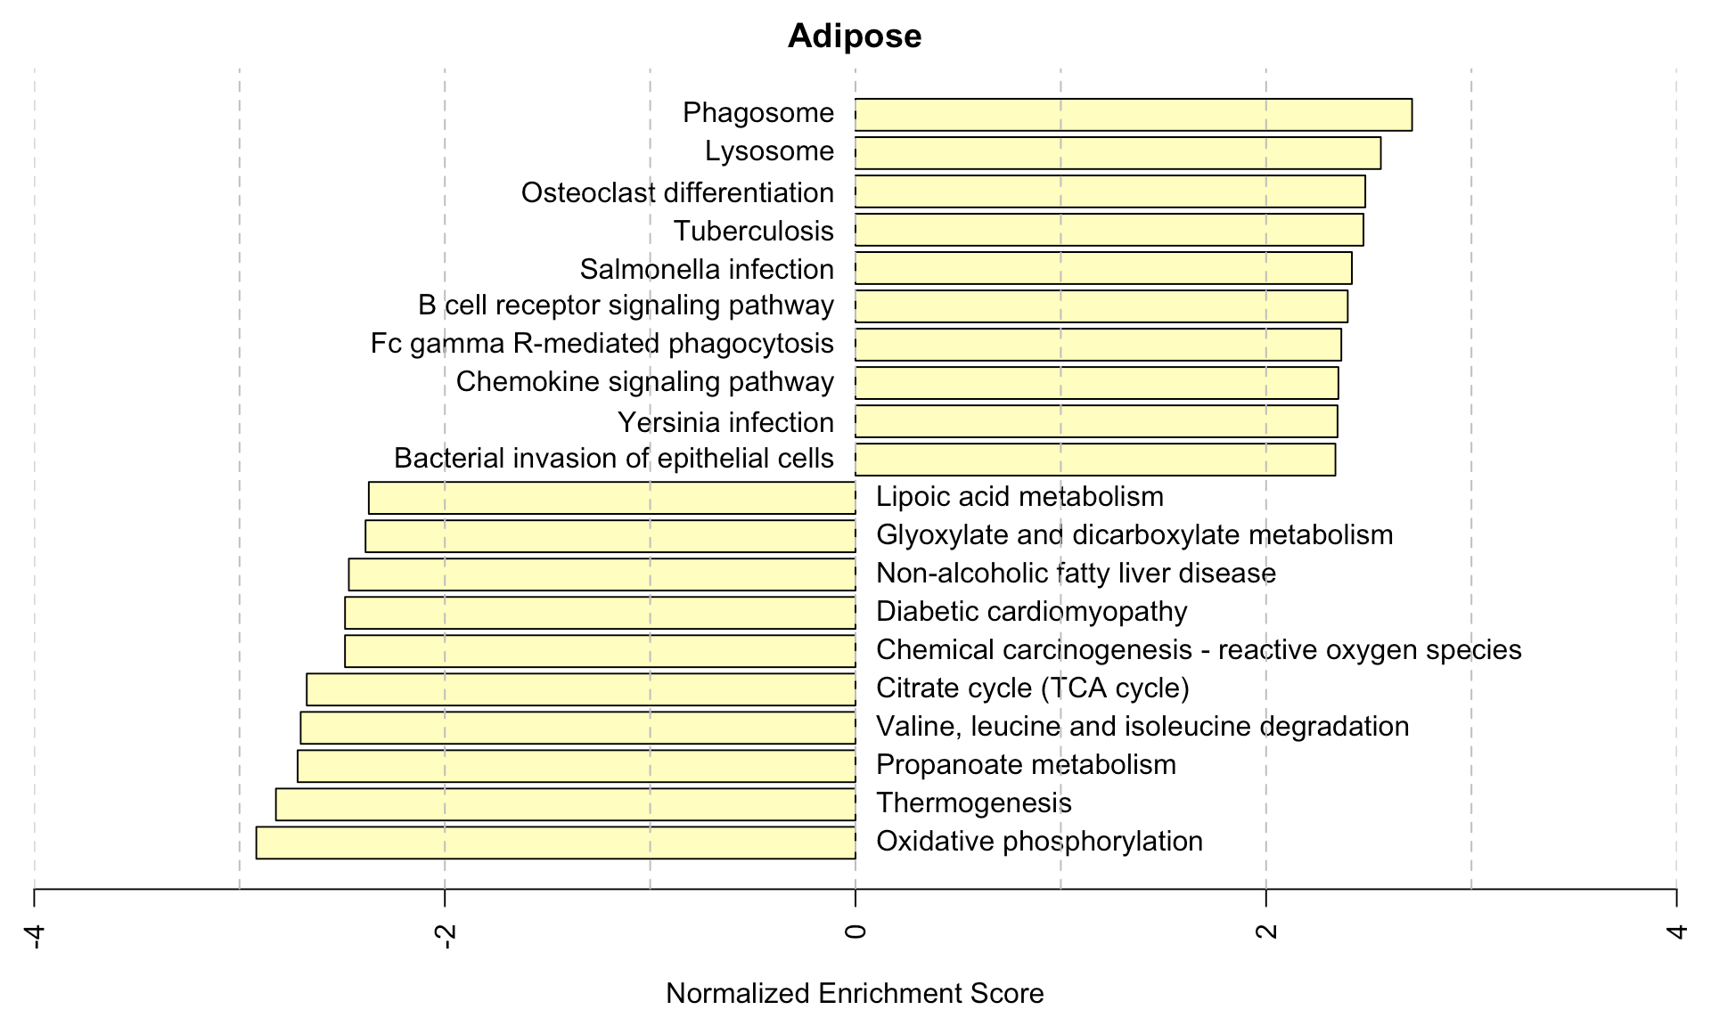
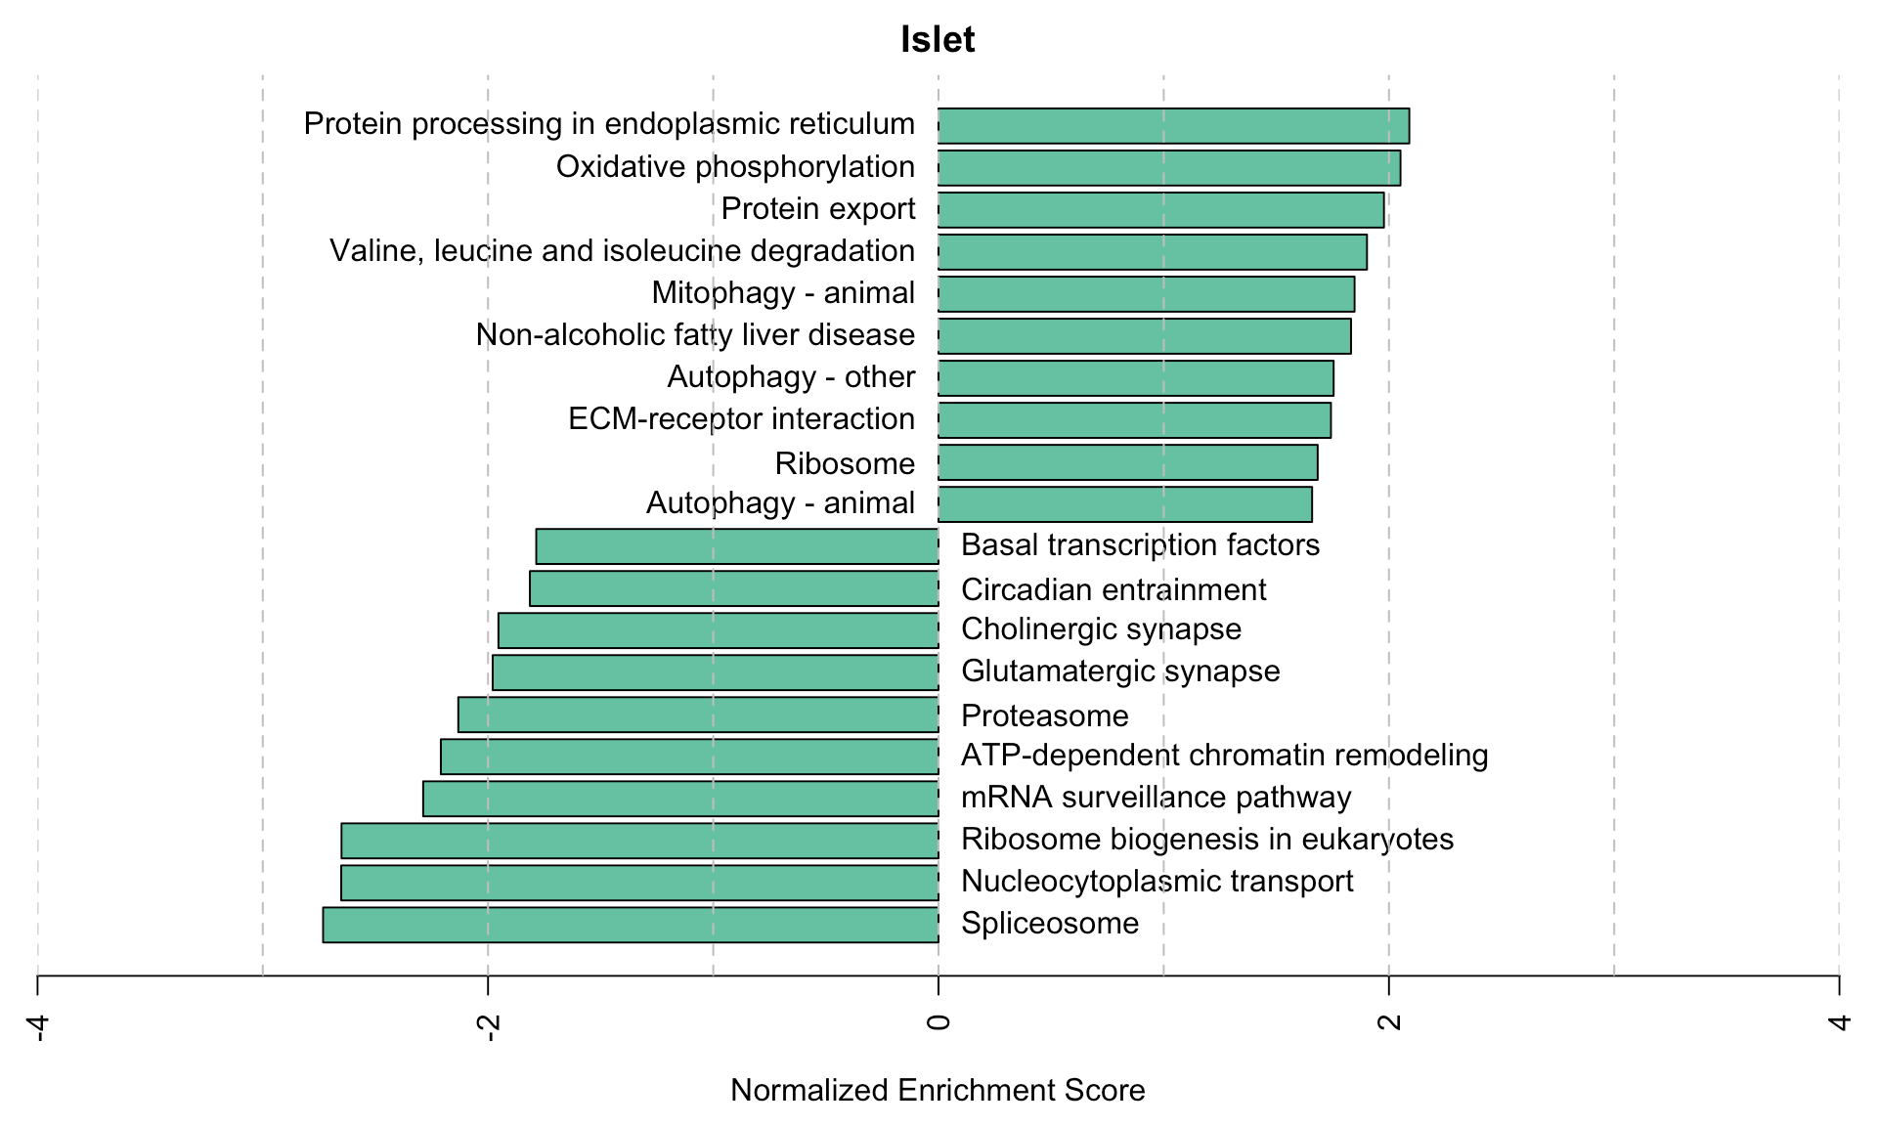
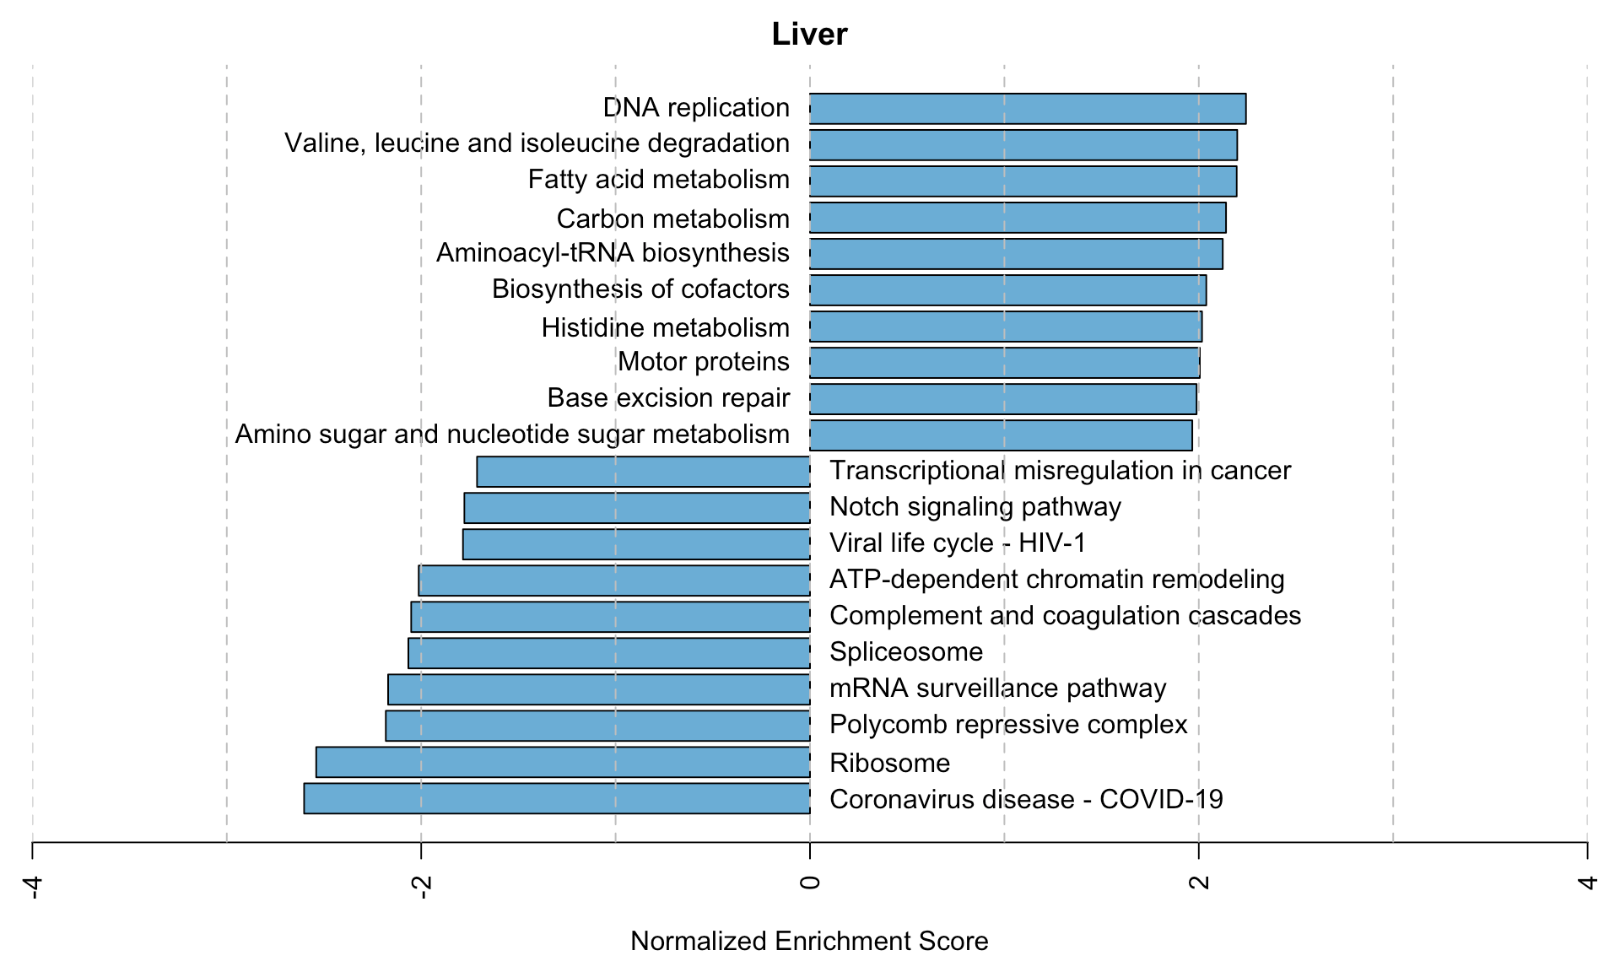
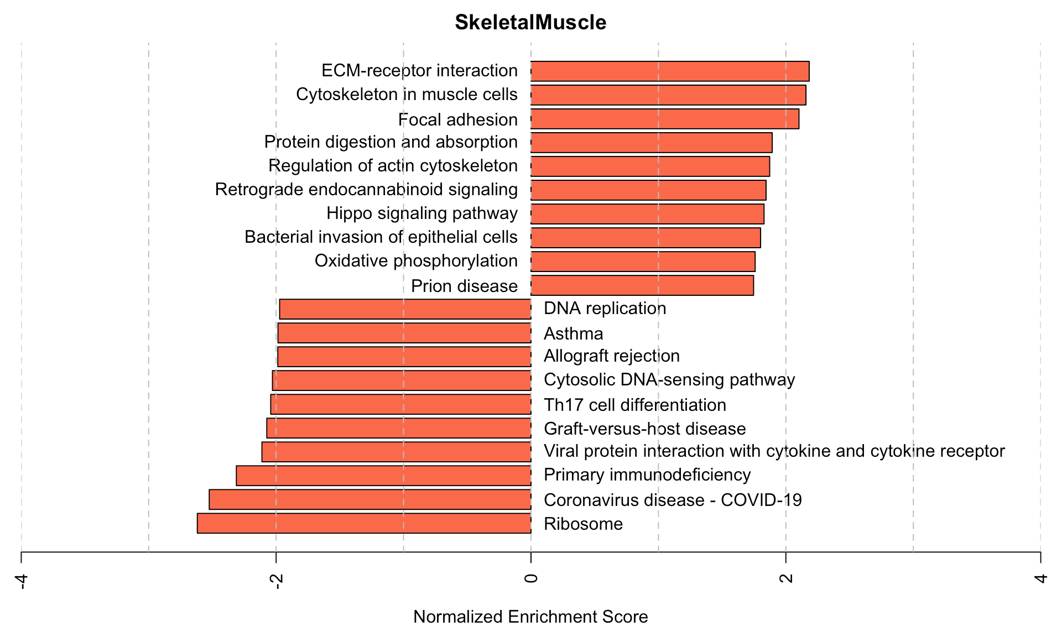
KEGG pathway enrichments by GSEA
Notes:
Bar plots showing normalized enrichment scores (NES) for KEGG pathways as determined by fast gene score enrichment analysis (fgsea). Only the top 10 positive and top 10 negative scores are shown. Colors indicate tissue. The name beside each bar shows the name of each enriched KEGG pathway.

Slide 7
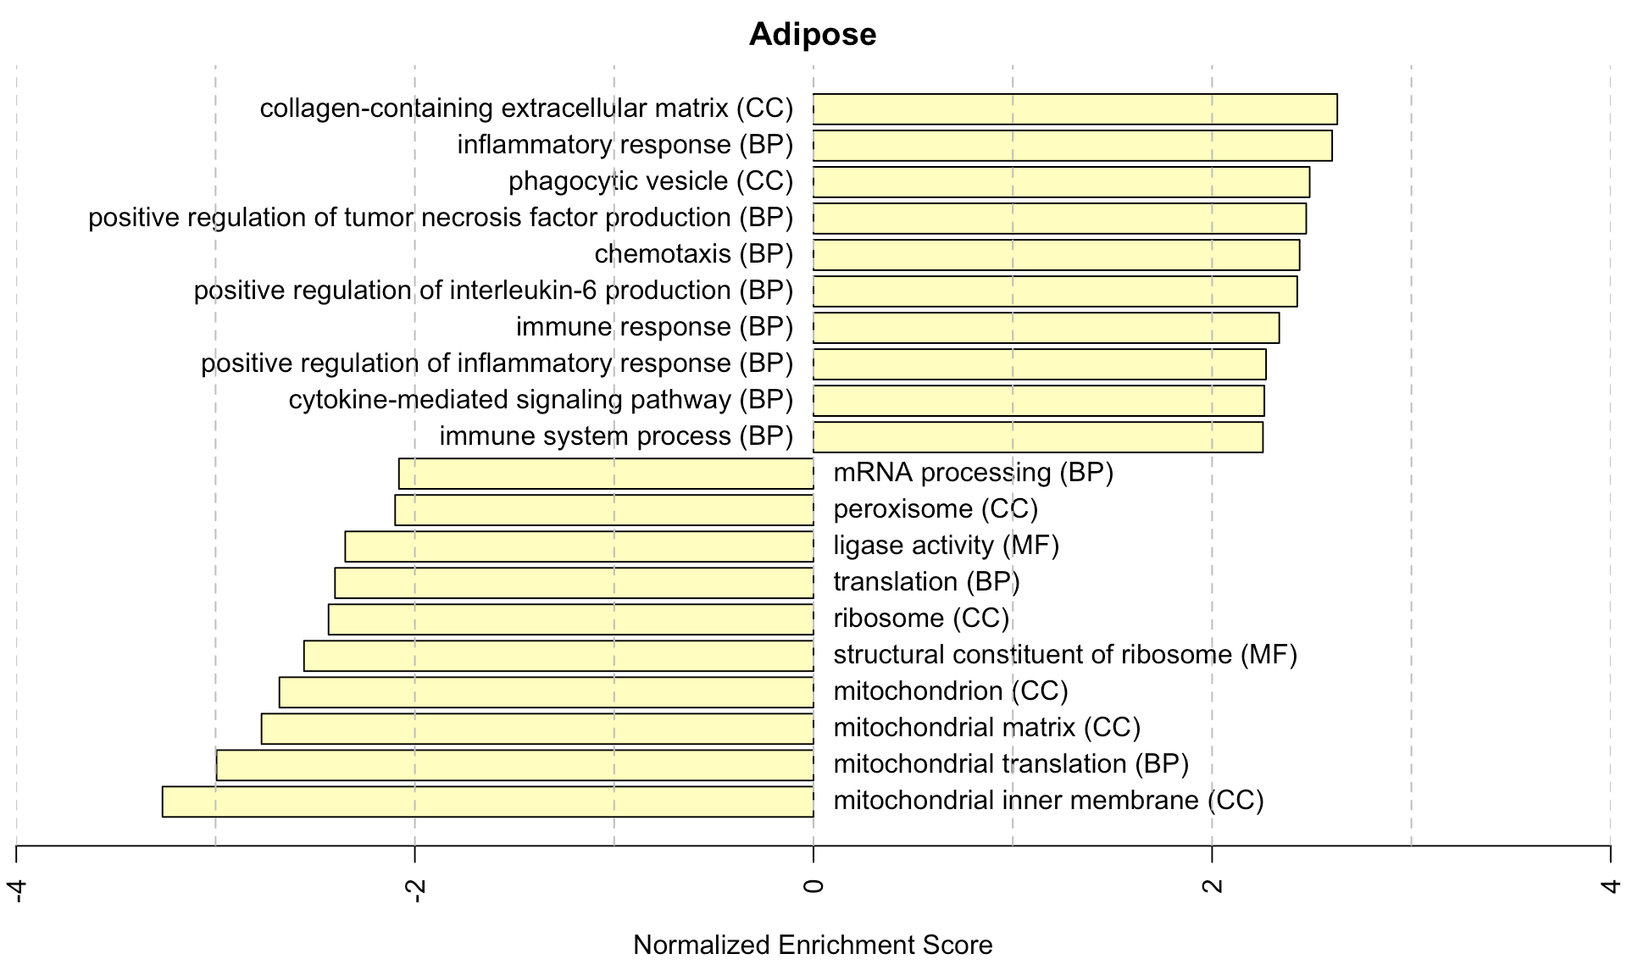
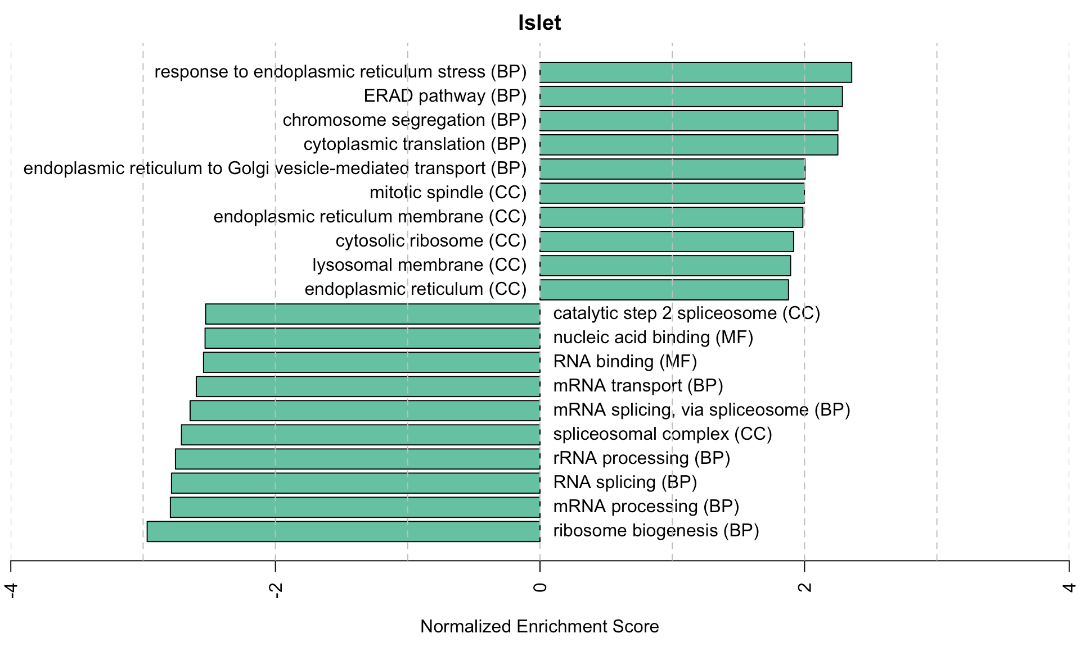
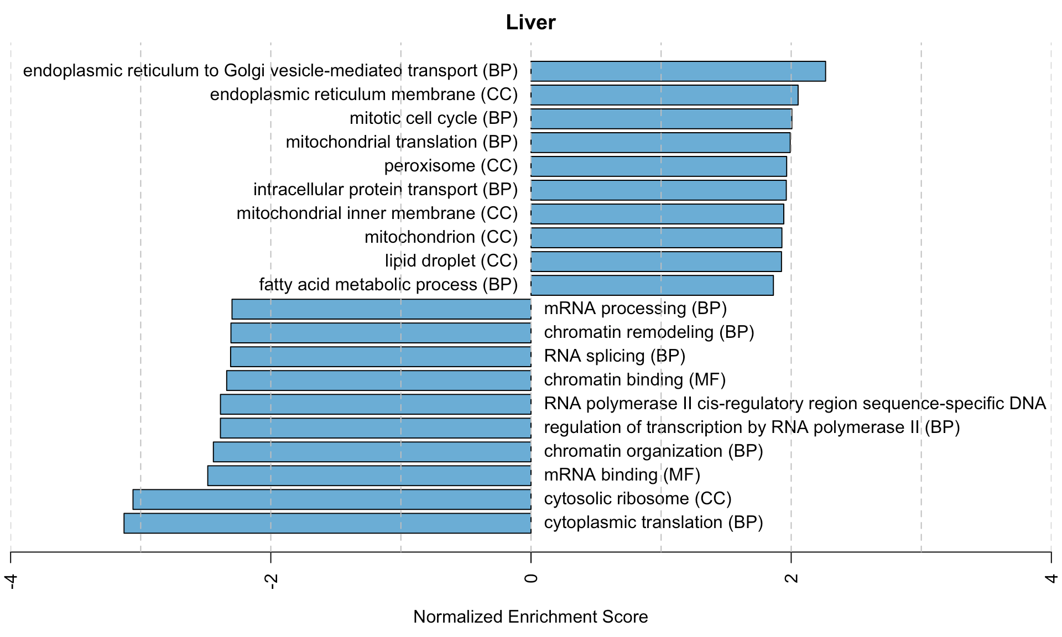
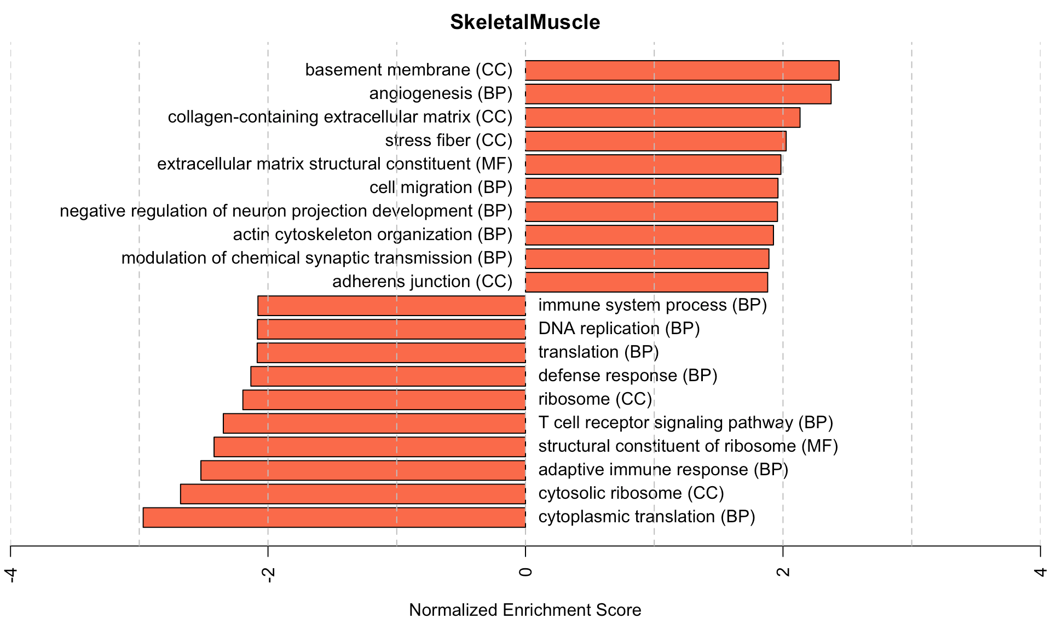
Top GO term enrichments by GSEA
Notes:
Bar plots showing normalized enrichment scores (NES) for GO
terms as determined by fast gene score enrichment analysis (fgsea).
Only the top 10 positive and top 10 negative scores are shown. Colors
indicate tissue. The name beside each bar shows the name of each enriched
GO term. The letters in parentheses indicate whether the term is from the
biological process ontology (BP), the molecular function ontology (MF),
or the cellular compartment ontology (CC).

Slide 8
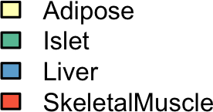
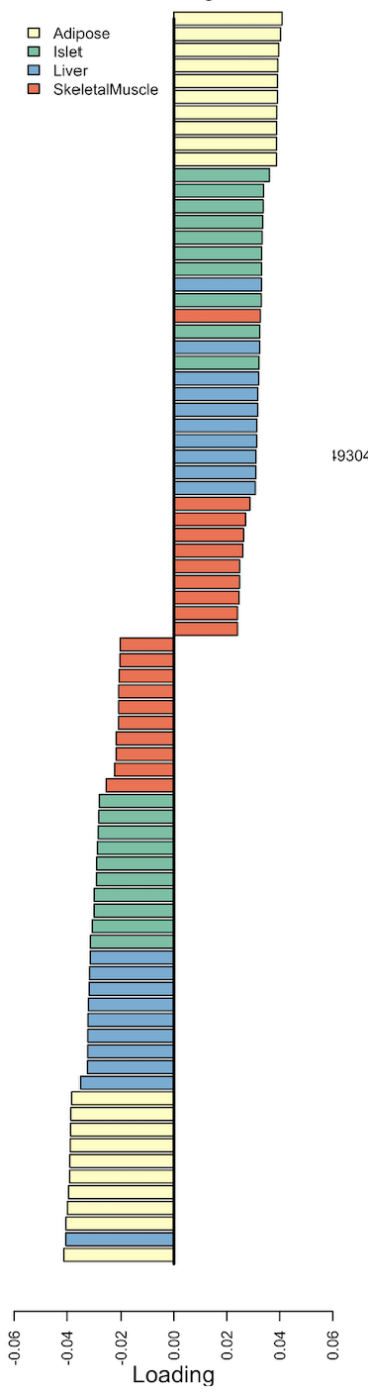
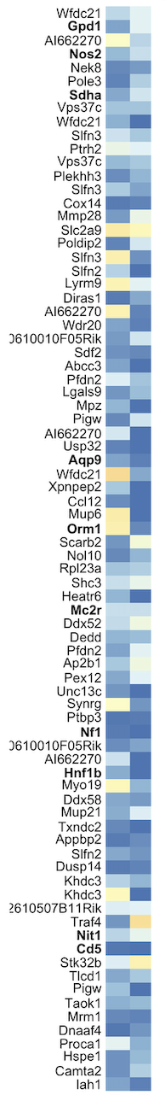
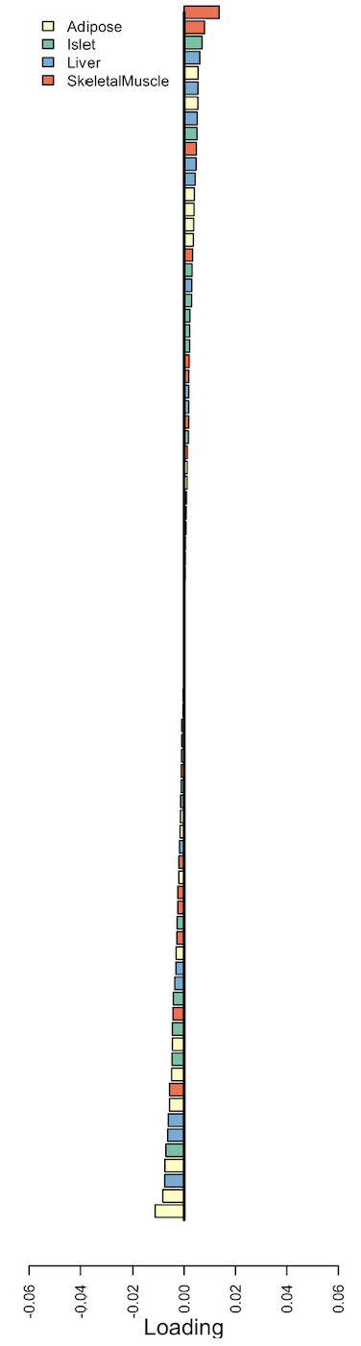
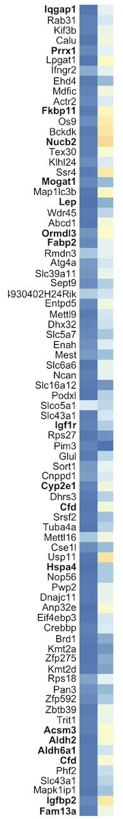
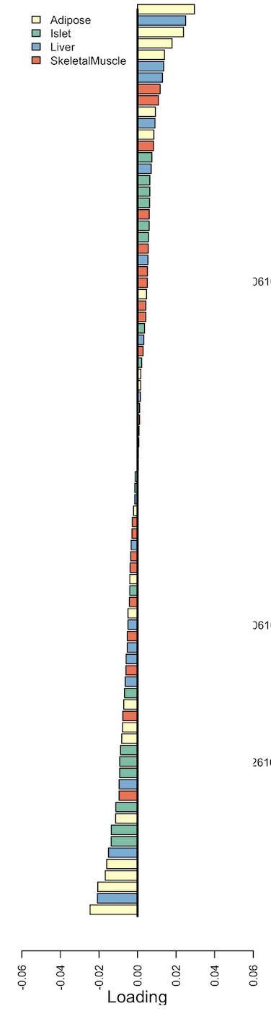
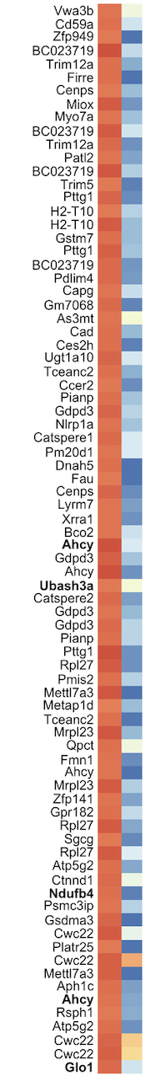
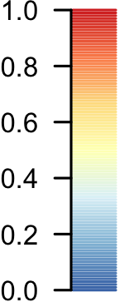
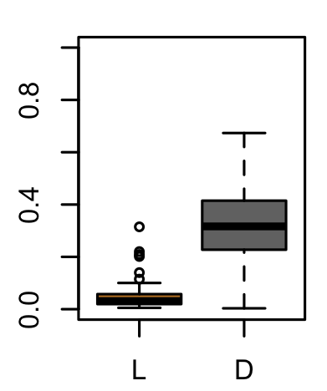
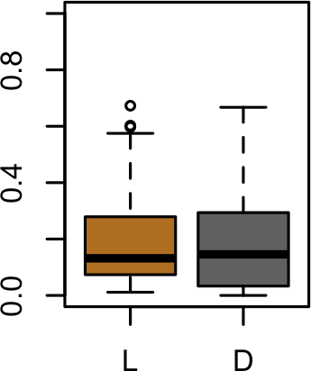
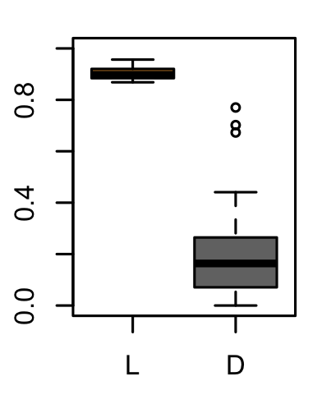
High-Loading
TWAS
High-Local Heritability
A
Loading
Heritability
B
Loading
Heritability
C
Loading
Heritability
Figure 5 - loadings, distal heritability, and local heritability comparison
L
D
L
D
L
D
Heritability
Heritability
Heritability
Heritability
Notes:
Transcripts with high loadings have high distal heritability and literature support. Each panel has a bar plot showing the loadings of transcripts selected by different criteria. Bar color indicates the tissue of origin. The heat map shows the local (L - left) and distal (D - right) heritability of each transcript. \textbf{A.} Loadings for the 10 transcripts with the largest positive loadings and the 10 transcripts with the largest negative loadings for each tissue. \textbf{B.} Loadings of TWAS candidates with the 10 largest positive correlations with traits and the largest negative correlations with traits across all four tissues. \textbf{C.} The transcripts with the largest local heritability (top 20) across all four tissues.
Main points
High-loading genes have relatively high distal heritability
High-heritability and TWAS genes have lower loadings
High-loading genes have 3 times more literature support than high-local heritability genes and 2 times more than TWAS hits (bolded gene names).
Literature support is defined as 2 or more abstracts with gene name, obesity OR diabetes, and tissue name.
High-heritability and TWAS hits appear in multiple tissues. (duplicate names in heat map)
High-loading genes are tissue-specific.
Notes:
Try adding box plots as another row underneath
Not sure if we should include box plots or not. They show distributions of local and distal heritability across all transcripts in each group.

Slide 9
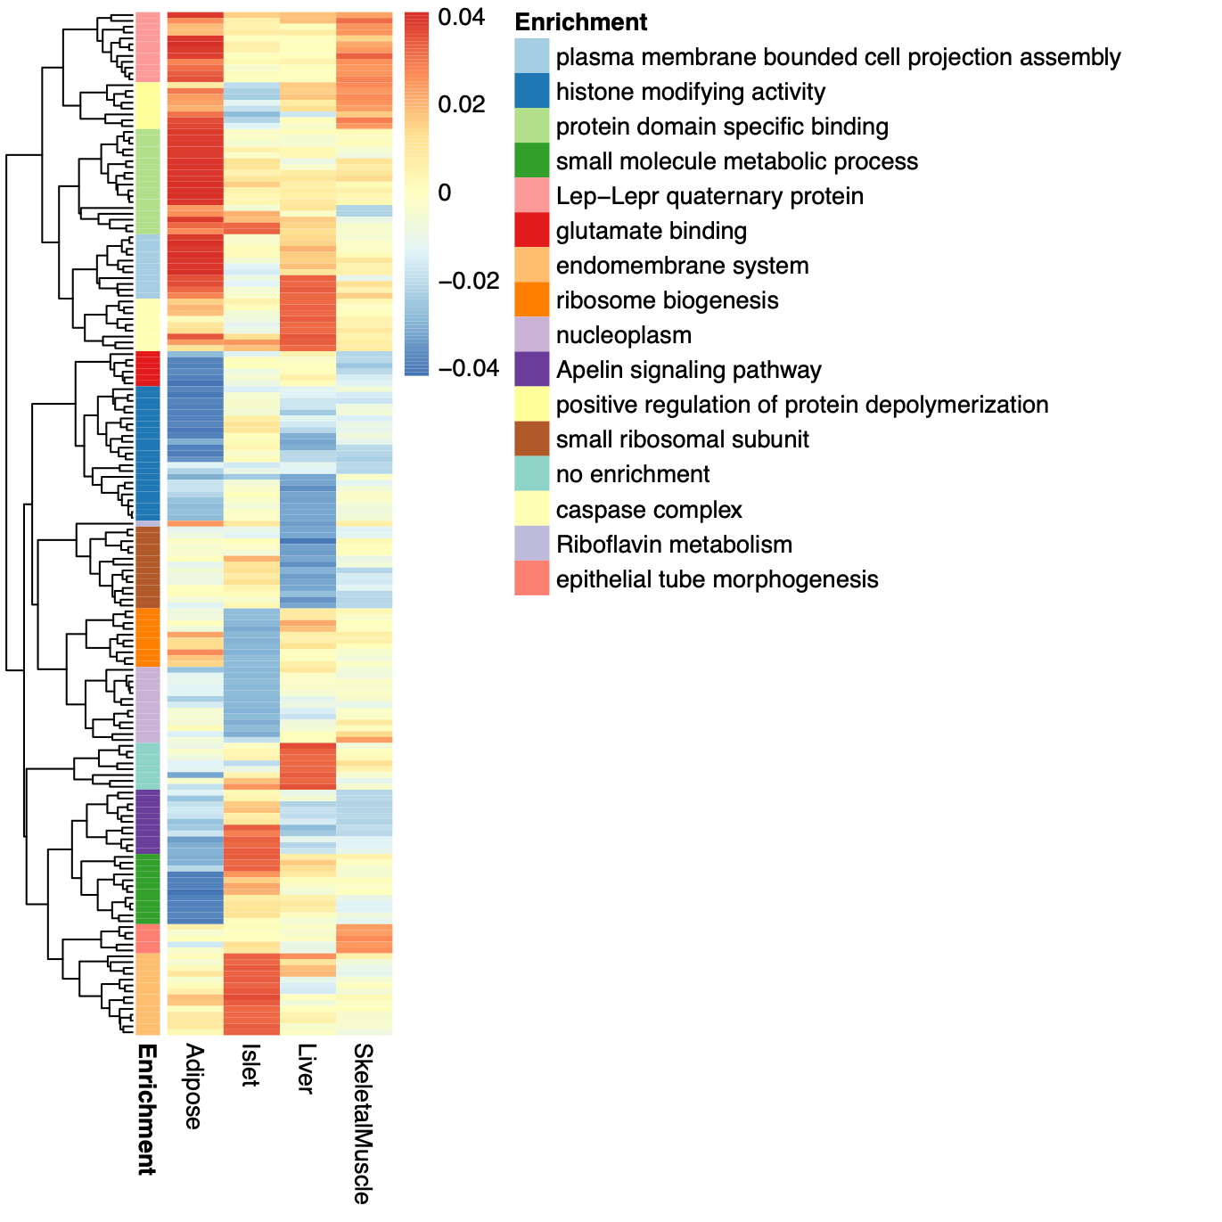
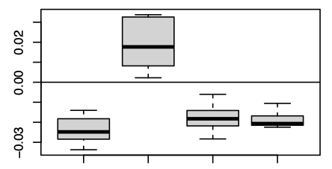
Figure 6: Tissues of action
A
B
Apelin Signaling
Loading
Adipose
Islet
Liver
Muscle
C
glucose
apelin
insulin
Notes:
Tissue-specific transcriptional programs are associated with obesity and insulin resistance. \textbf{A.} Heat map showing the loadings of all transcripts with loadings greater than 2.5 standard deviations from the mean in any tissue. The heat map is hierarchically clustered. Functional enrichment of each cluster is indicated by color. An example cluster enriched for apelin signaling is highlighted. \textbf{B.} The distribution of the loadings of the apelin cluster across all tissues. These transcripts have positive loadings in the islet, and negative loadings in all other tissues. \textbf{C.} Model showing the interactions between glucose-stimulated insulin secretion by the pancreas and apelin signaling in skeletal and adipose tissue.

Slide 10
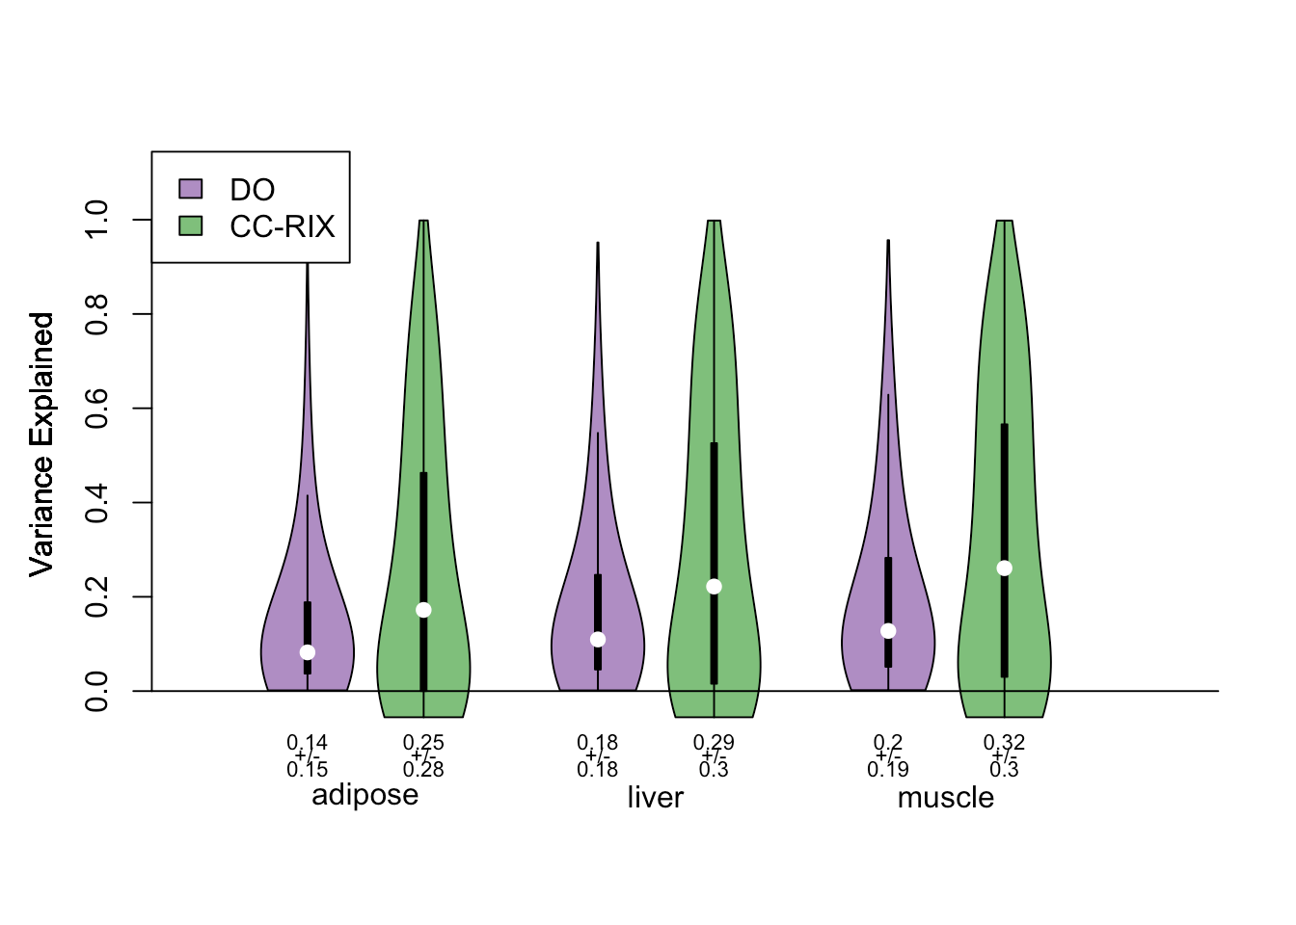
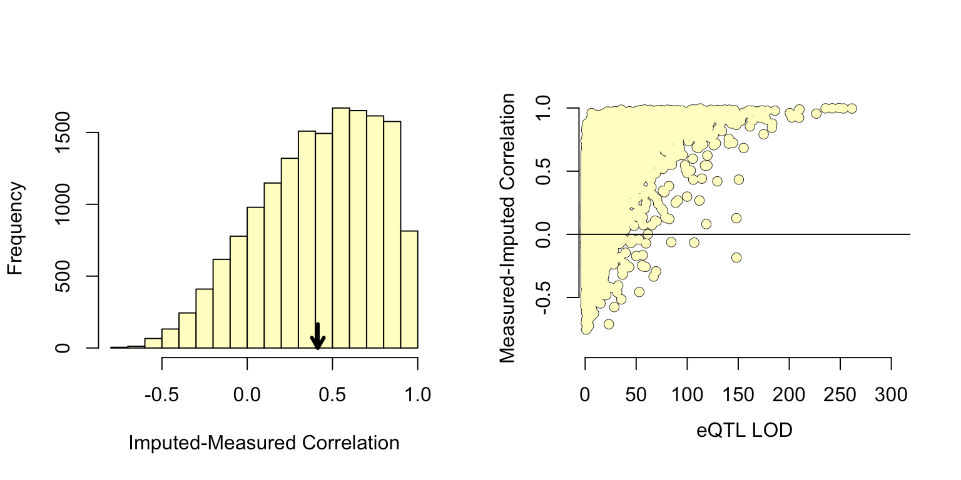
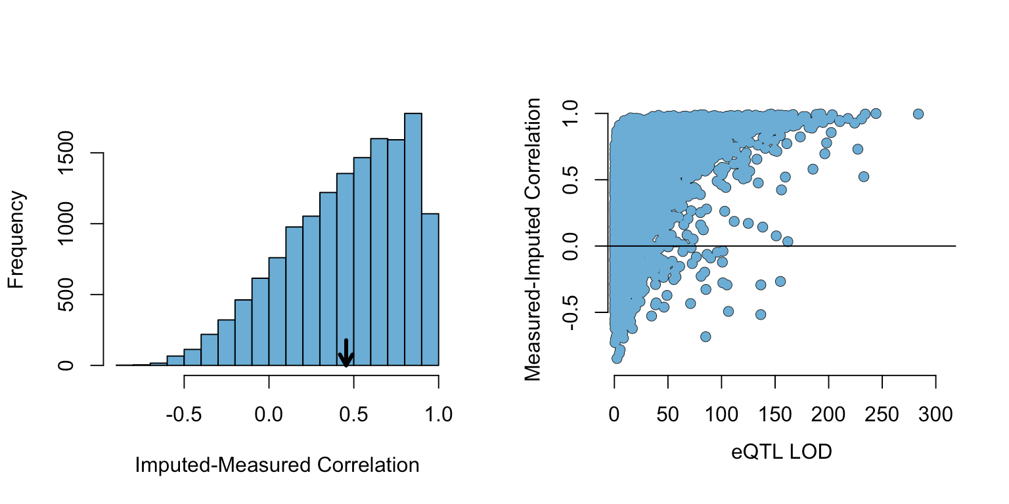

Supplemental Figure
A
imputed-measured correlation
B
Correlation vs. eQTL LOD
C
Adipose
Adipose
Liver
Skeletal Muscle
Liver
Muscle
Notes:
Validation of transcript imputation in the CC-RIX. \textbf{A.} Distributions of correlations between imputed and measured transcripts in the CC-RIX. The mean of each distribution is shown by the red line. All distributions were skewed toward positive correlations and had positive means near a Pearson correlation (r) of 0.5. \textbf{B.} The relationship between the correlation between measured and imputed expression in the CC-RIX (x-axis) and eQTL LOD score. As expected, imputations are more accurate for transcripts with strong local eQTL. \textbf{C.} Variance explained by local genotype in the DO and CC-RIX.

Slide 11






Figure 7: CC-RIX validation
A
DO mice
B
T
P
G
T
P
Transcripts
Local Haplotype
Bulk RNA Seq
Adipose
Liver
Skeletal Muscle
DO eQTL analysis
Body Weight
Body Weight
Adipose
eQTL analysis
local eQTL
Predicted PC
Predicted PC
CC-RIX mice
Liver
Transcripts
Local Haplotype
Body Weight
Body Weight
CC-RIX Imputation
Bulk RNA Seq
Adipose
Liver
Skeletal Muscle
Predicted PC
Predicted PC
Impute Locally Regulated Transcription
HDMA in DO mice
Imputed gene expression
Transcript Loadings
Muscle
Body Weight
Body Weight
Prediction
Locally controlled transcripts for each individual
Effect of increased expression on phenotype score
Predict Traits from locally regulated transcription
Predicted PC
Predicted PC
Notes:
Transcription, but not local genotype, predicts phenotype in the CC-RIX. \textbf{A.} Workflow showing procedure for translating HDM results to an independent population of mice. \textbf{B.} Relationships between the predicted metabolic index and measured body weight. The left column shows the predictions using measured transcripts. The right column shows the prediction using transcript levels imputed from local genotype. Gray boxes indicate measured quantities, and blue boxes indicate calculated quantities.
Notes:
use a diagram to head the columns - depict the model, don't use imputed/measured
for columns start with measured
use tissue colors?

Slide 12


Figure 7: CC-RIX validation
A
DO mice
B
T
P
G
T
P
Transcripts
Local Haplotype
Bulk RNA Seq
Adipose
Liver
Skeletal Muscle
DO eQTL analysis
Adipose
eQTL analysis
local eQTL
CC-RIX mice
Transcripts
Local Haplotype
Liver
CC-RIX Imputation
Bulk RNA Seq
Adipose
Liver
Skeletal Muscle
Impute Locally Regulated Transcription
HDMA in DO mice
Imputed gene expression
Transcript Loadings
Muscle
Prediction
Locally controlled transcripts for each individual
Effect of increased expression on phenotype score
Predict Traits from locally regulated transcription
Notes:
Transcription, but not local genotype, predicts phenotype in the CC-RIX. A. Workflow showing procedure for translating HDM results to an independent population of mice. B. Relationships between the predicted metabolic index and measured body weight. The left column shows the predictions using measured transcripts. The right column shows the prediction using transcript levels imputed from local genotype. Gray boxes indicate measured quantities, and blue boxes indicate calculated quantities.
Notes:
use a diagram to head the columns - depict the model, don't use imputed/measured
for columns start with measured
use tissue colors?

Slide 13


Figure 7: CC-RIX validation
A
DO mice
B
T
P
G
T
P
Transcripts
Local Haplotype
Bulk RNA Seq
Adipose
Liver
Skeletal Muscle
DO eQTL analysis
Adipose
eQTL analysis
local eQTL
CC-RIX mice
Transcripts
Local Haplotype
Liver
CC-RIX Imputation
Bulk RNA Seq
Adipose
Liver
Skeletal Muscle
Impute Locally Regulated Transcription
HDMA in DO mice
Imputed gene expression
Transcript Loadings
Locally controlled transcripts for each individual
Effect of increased expression on phenotype score
Muscle
Prediction
Predict Traits from locally regulated transcription
This version shows we can predict strain body weight with expression,
but not with genotype
Notes:
Transcription, but not local genotype, predicts phenotype in the CC-RIX. A. Workflow showing procedure for translating HDM results to an independent population of mice. B. Relationships between the predicted metabolic index and measured body weight. The left column shows the predictions using measured transcripts. The right column shows the prediction using transcript levels imputed from local genotype. Gray boxes indicate measured quantities, and blue boxes indicate calculated quantities. The dots in each panel represent individual CC-RIX strains. The gray lines show the standard deviation on body weight for the strain.
Notes:
use a diagram to head the columns - depict the model, don't use imputed/measured
for columns start with measured
use tissue colors?

Slide 14







Figure 8: Human Translation
A
B
D
obesity in children
obesity in post-menopausal women
Score
Score
p = 0.038
p = 0.011
C
normal
weight
obese
lean
obese
diabetic vs. non-diabetic
diabetic vs. non-diabetic
Score
Score
p = 0.005
p = 0.015
non-diabetic
diabetic
non-diabetic
diabetic
Notes:
HDM results translate to humans. \textbf{A.} Distribution of loadings for cell-type-specific transcripts in adipose tissue. \textbf{B.} Distribution of loadings for cell-type-specific transcripts in pancreatic islets (green). \textbf{C.} Null distributions for the mean loading of randomly selected transcripts in each cell type compared with the observed mean loading of each group of transcripts (red asterisk). \textbf{D.} Predictions of metabolic phenotypes in four adipose transcription data sets downloaded from GEO. In each study the obese/diabetic patients were predicted to have greater metabolic disease than the lean/non-diabetic patients based on the HDM results from DO mice.
Should we combine the box plots into one plot?

Slide 15





Figure 2: Tissue transcription overview - put this in supplementals
A
B
Adipose
G
Shared local eQTL
Transcript gene position
eQTL count
eQTL position
C
Liver
D
Islet
Transcript gene position
Transcript gene position
H
Shared Distal eQTL
eQTL position
eQTL position
E
Skeletal Muscle
F
eQTL count
Transcript gene position
eQTL position
Notes:
Overview of eQTL analysis in DO mice. \textbf{A.} RNA seq samples from the four different tissues clustered by tissue. \textbf{B.-E.} eQTL maps are shown for each tissue. The $x$-axis shows the position of the mapped eQTL, and the $y$-axis shows the physical position of the gene encoding each mapped transcript. Each dot represents an eQTL with a minimum LOD score of 8. The dots on the diagonal are locally regulated eQTL for which the mapped eQTL is at the within 4Mb of the encoding gene. Dots off the diagonal are distally regulated eQTL for which the mapped eQTL is distant from the gene encoding the transcript. \textbf{F.} Comparison of the total number of local and distal eQTL with a minimum LOD score of 8 in each tissue. All tissues have comparable numbers of eQTL. Local eQTL are much more numerous than distal eQTL. \textbf{G.} Counts of transcripts with local eQTL shared across multiple tissues. The majority of local eQTL were shared across all four tissues.
\textbf{H.} Counts of transcripts with distal eQTL shared across multiple tissues. The majority of distal eQTL were tissue-specific and not shared across multiple tissues. For both G and H, eQTL for a given transcript were considered shared in two tissues if they were within 4Mb of each other. Colored bars indicate the counts for individual tissues for easy of visualization.

Slide 16

Tested KEGG pathways for enrichment of positive or negatively loadings (GSEA)
Adipose tissue had the strongest enrichments, both positive and negative

Slide 17

Oxidative phosphorylation was the most strongly negatively loaded gene according to GSEA
This indicates that up-regulation of OxPhos genes is associated with a more negative metabolic index (leaner mice)
adjusted GSEA pvalues

Slide 18

Basically all genes in this pathway are negatively loaded
scaled to minimum and maximum overall loadings

Slide 19

Thermogenesis was the second-most negatively loaded pathway
Thermogenesis genes in adipose tissue had many negative loadings, indicating that up-regulating these genes is associated with a lower metabolic index (leaner)

Slide 20

Many genes associated with this pathway had negative loadings
scaled to minimum and maximum overall loadings

Slide 21

Phagosome was the most positively loaded pathway in adipose tissue, according to GSEA
Up-regulation of genes associated with phagosomes were associated with greater metabolic index (more obese) - probably related to tissue composition, i.e. more macrophages

Slide 22

scaled to minimum and maximum overall loadings
Basically all genes associated with this pathway were positively loaded.

Slide 23

Lysosome was the second most positively loaded pathway in adipose tissue, according to GSEA
Also probably related to increase in macrophages

Slide 24

scaled to minimum and maximum overall loadings
Many of the genes associated with this pathway were positively loaded.

Slide 25

Valine, leuceine, and isoleuceine (branched-chain amino acid - BCAA) metabolism was highly enriched in negatively loaded adipose tissue in our original analysis.
The BCAA degradation pathway in this analysis was highly negatively loaded.

Slide 26

Almost all genes in this pathway were negatively loaded.
scaled to minimum and maximum overall loadings

